Slide 1
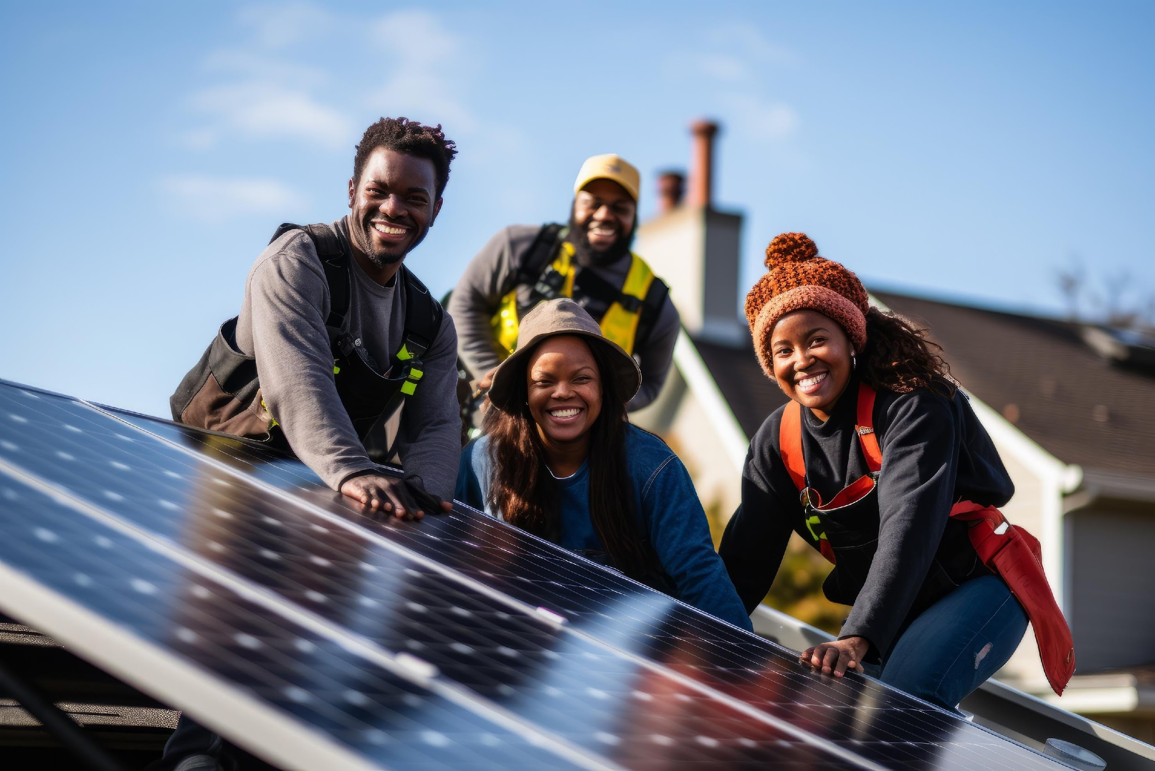
Massachusetts Climate Careers: Powering the Future
Climate Solutions for Our Homes and Schools
Lesson 3: Climate Solutions for Our Homes and Schools
|
Notes:
This lesson is focused on how we can make everyday spaces more climate-friendly.

Slide 2
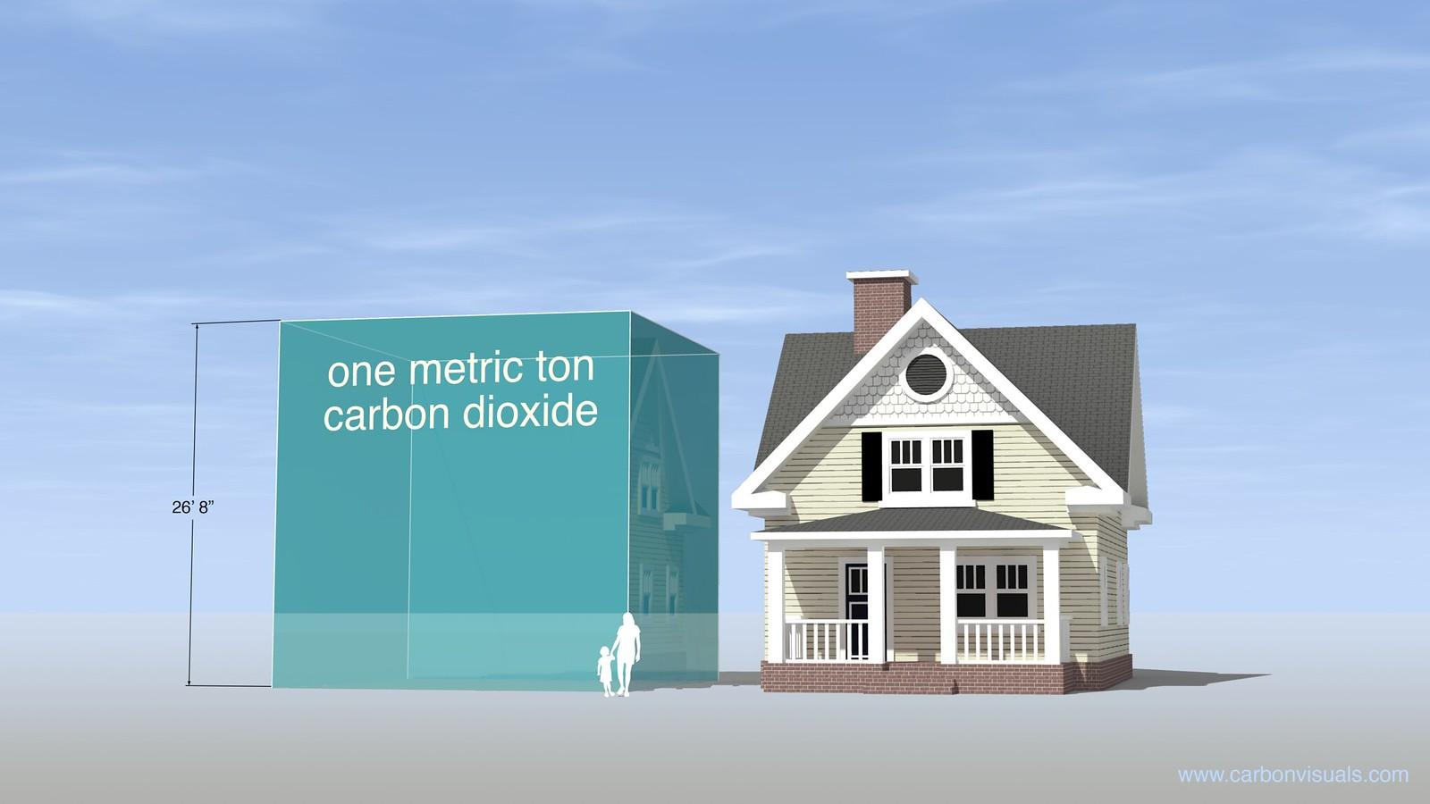
Massachusetts schools produce 880,000 metric tons of carbon every year.
How can schools help reduce this?
Notes:
Encourage students to reflect on the school’s potential emissions, and ask them what changes could make a difference here.
This is something we’ll have a chance to explore later today!

Slide 3
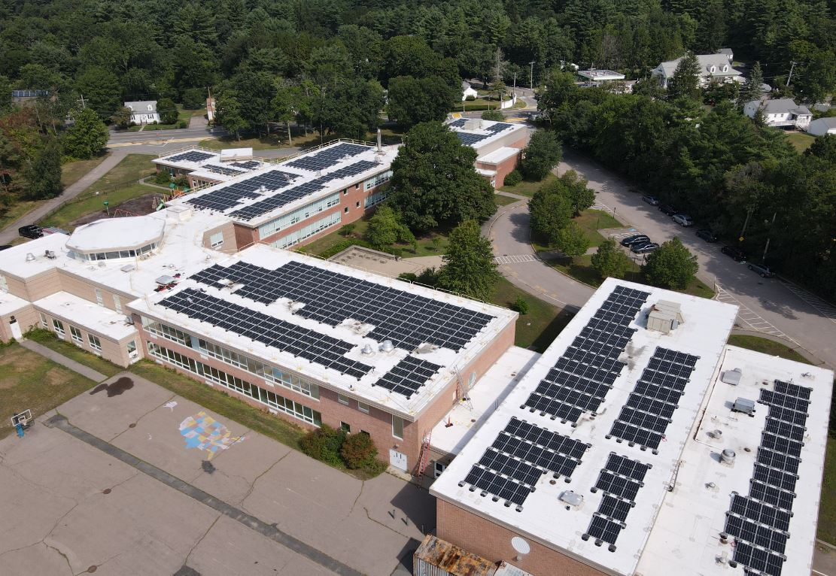
Your School Can Be a Climate Solution
Solar panels at Heights Elementary School
Offset 540,000 pounds of CO2
Save $30,000 in energy costs
…every year!
A total of 722 solar panels power Heights Elementary School in Sharon, Massachusetts.
Notes:
Quickly introduce the lesson structure so that students know what to expect.
Today’s focus will be learning how climate change affects our lives and how we can be part of the solution.
Key point to emphasize: This is an exciting opportunity to see how you can make a difference now and in the future.

Slide 4
Opening Activity
Carbon footprint: Total amount of carbon emissions produced through regular activities
Weatherization: Making a building more resistant to outdoor temperatures
Renewable energy: Energy from sources that naturally replenish
Solar panels: Devices that convert sunlight into electricity
Insulation: Material inside walls and ceilings to help keep heat in or out
Heat pump: Device that transfers heat from outside to inside in winter or from inside to outside in summer
Notes:
Activity objective: Introduce critical vocabulary related to climate technology in a non-technical way that encourages curiosity, engages critical thinking, and prepares students for the concepts covered in the lesson. This allows students to make educated guesses and become familiar with terms they’ll encounter throughout the lesson and course.
Instructions:
Students will explore new vocabulary related to climate solutions that help homes and schools use energy more efficiently and reduce carbon emissions. They may not know all of the terms, but they should make their best effort to guess the meaning before the answer is revealed.
Show each word one at a time. Click to display each vocabulary word, then click again to reveal the definition (on animations).
For each word, ask students what they think it means, and call on two to three students to share their responses before revealing the answer.
Encourage creative thinking and collaboration between students; the purpose is to engage students rather than insist on correct answers.
Close the activity by explaining that today’s lesson will explore how some of these solutions relate to spaces that students occupy every day: homes and schools.

Slide 5
The Big Question and My Climate Goals
Climate Watch and Discussion
Climate Solutions at Home and School
Energy Audit Activity
Closing Activity

Slide 6
How can climate technologies help homes and schools become part of the climate solution?
Notes:
Ask the students for one example of something they’ve seen that helps reduce emissions at home or at school.
Those could all be examples of climate technologies.
Today, we’ll explore technologies that make everyday spaces more sustainable and energy efficient.

Slide 7
When you complete this lesson, you’ll be able to
Explain how solutions such as weatherization, heat pumps, solar energy, efficient appliances, and battery storage make homes and schools climate solutions
Discuss how your own home, school, and community can be part of the climate solution.
My Climate Goals
Notes:
Outline the learning goals.
Today’s lesson will provide tools students can use in their lives today and in their future careers.
Today’s learning goals connect directly to real-world skills and solutions to the climate crisis.

Slide 8
Climate Watch: Video
Lesson 3: Climate Solutions for Our Homes and Schools
Notes:
Video available early 2025: Solect Energy School Project
After the video, ask students what stood out to them about the video.
What part of the video inspired you the most?
Is there anything you want to learn more about or try here?

Slide 9
What are some of the benefits of a solar canopy at the school?
What are some of the job roles needed for a commercial solar project?
Why are so many schools in Massachusetts investing in solar electric systems?
Climate Watch Discussion
Lesson 1. Understanding and Combating Climate Change

Slide 10
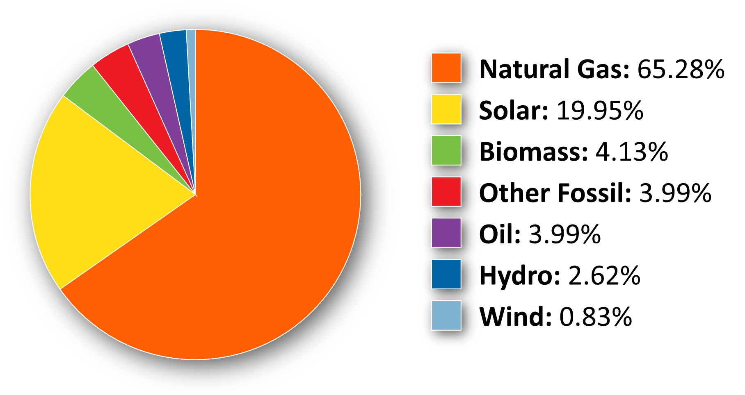
Electricity Grid Mix in Massachusetts
Based on EIA data from 2022
Notes:
Let’s look at where our electricity comes from here in Massachusetts.
Massachusetts relies heavily on natural gas, a fossil fuel like oil or coal.
Its extraction, transport, and use (burning) release greenhouse gases that drive climate change.
In some buildings, natural gas is burned directly for heating, cooking, or specific industrial processes (manufacturing and agriculture, for example).
Natural gas is also burned in power plants to generate electricity that is then used to power homes, schools, businesses, hospitals, coffee shops, or anywhere on the grid.
This data is from 2022, so it may have changed slightly, but it’s likely to be pretty accurate even today.
There are two main ways we can lessen the impact of our energy use on the climate. Ask students to identify them.
Change the power source (generate power from solar or wind, for example).
Use less energy, lowering the demand for energy sources such as natural gas.
New technologies are constantly being introduced that help reduce carbon emissions, make our homes and vehicles more efficient, and lower the demand for energy use.
You are probably familiar with many of them already.

Slide 11
Climate Solutions
Are Everywhere
Clean energy technology can reduce energy use and lower emissions.
Solar panels
Energy-efficient appliances
LED light bulbs
Heat pumps
Electric vehicles
Improving building weatherization
Industrial recycling
Courtesy XXXXXX
Notes:
Review the climate solution technologies listed on the slide, and ask students if they have seen or know of any that aren’t listed here.
Ask students if anyone has any of these in their homes, or if they have them in the neighborhood.
These technologies are available today and are key to reducing our carbon footprint.
By reducing the carbon footprint, we help combat climate change and are part of the solution.
All of these solutions require people to design, implement, and manage them.
The more we see climate solutions popping up in our homes, schools, communities, and everywhere else, the more we’re going to see demand for all kinds of clean energy jobs increase.

Slide 12
MA Schools Lead Clean Energy
One of the top five US states for solar installation in schools
Installing solar panels, improving energy efficiency, and electrifying school buses
Community hubs for clean energy projects
Courtesy XXXXXX
Notes:
Review the climate solution technologies listed on the slide and ask students if they have seen or know of any that aren’t listed.
Ask the students if anyone has any of these in their homes or if they have them in the neighborhood.
These technologies are available today and are key to reducing our carbon footprint.
By reducing the carbon footprint, we help combat climate change and are part of the solution.
These solutions require people to design, implement, and manage them.
The more climate solutions pop up in our homes, schools, communities, and everywhere else, the more demand for all kinds of clean energy jobs will increase.

Slide 13
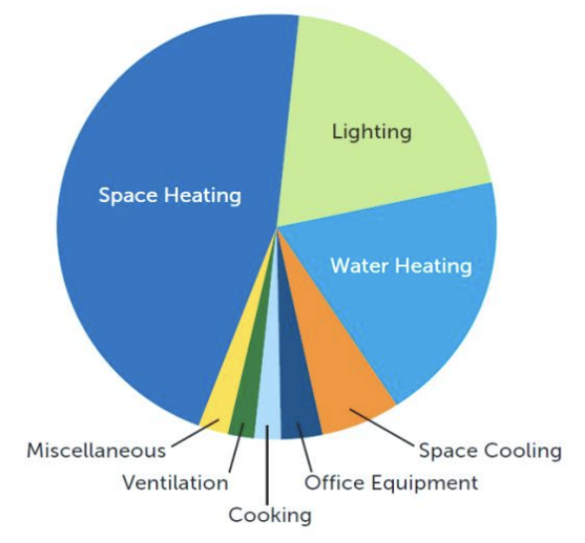
Today’s Group Activity
Energy audit: How can we reduce energy use in our school?
Work in groups to examine how our school uses energy.
Identify three to five ways to save energy and make our school more energy efficient.
End uses of total energy (electricity, natural gas, etc.) in K-12 Schools. Courtesy: US Department of Energy, Energy Solutions for School Buildings, 2006.
www1.eere.energy.gov/buildings/energysmartschools/about.html
Notes:
Activity objective: Help students think critically about energy usage in their school and how simple changes can lead to significant energy savings while connecting to their potential future role in clean energy careers.
Introduction: One clean energy career path you may not have heard much about before is an energy auditor. That’s someone who evaluates buildings such as homes and schools and recommends ways to improve efficiency, reduce energy use, and minimize a building’s carbon footprint or environmental impact. Today, you are going to be the energy auditors for our school.
Instructions:
Divide the class into groups of three to four students.
Students will do a brief energy audit of their school, focusing on lighting, heating, and electricity use. (12 mins)
(If possible) Have groups walk around the classroom or nearby areas (e.g., hallways and restrooms) to identify things such as the following:
Are the lights always on, even when no one is in the room?
Are computers, screens, or projectors left on?
Are windows closed when the heating or cooling is on?
Groups will list three to five things they found that use energy unnecessarily or could be improved, make suggestions, and share their findings with the class.
Presentations/debrief discussion guidance: (7 mins)
Ask each group to share one finding with a suggestion for improvement.
Ideas might include automatic lights, energy-efficient appliances, or better heating controls.
Ask students if they were surprised by anything they discovered in their audits or excited by any of their or their classmates’ suggestions for improvements.
Conclusion: Saving energy is one of the easiest ways to reduce our carbon footprint. What we did today is similar to what energy auditors do—they help people and businesses save energy so they can implement simple changes with a big impact.

Slide 14
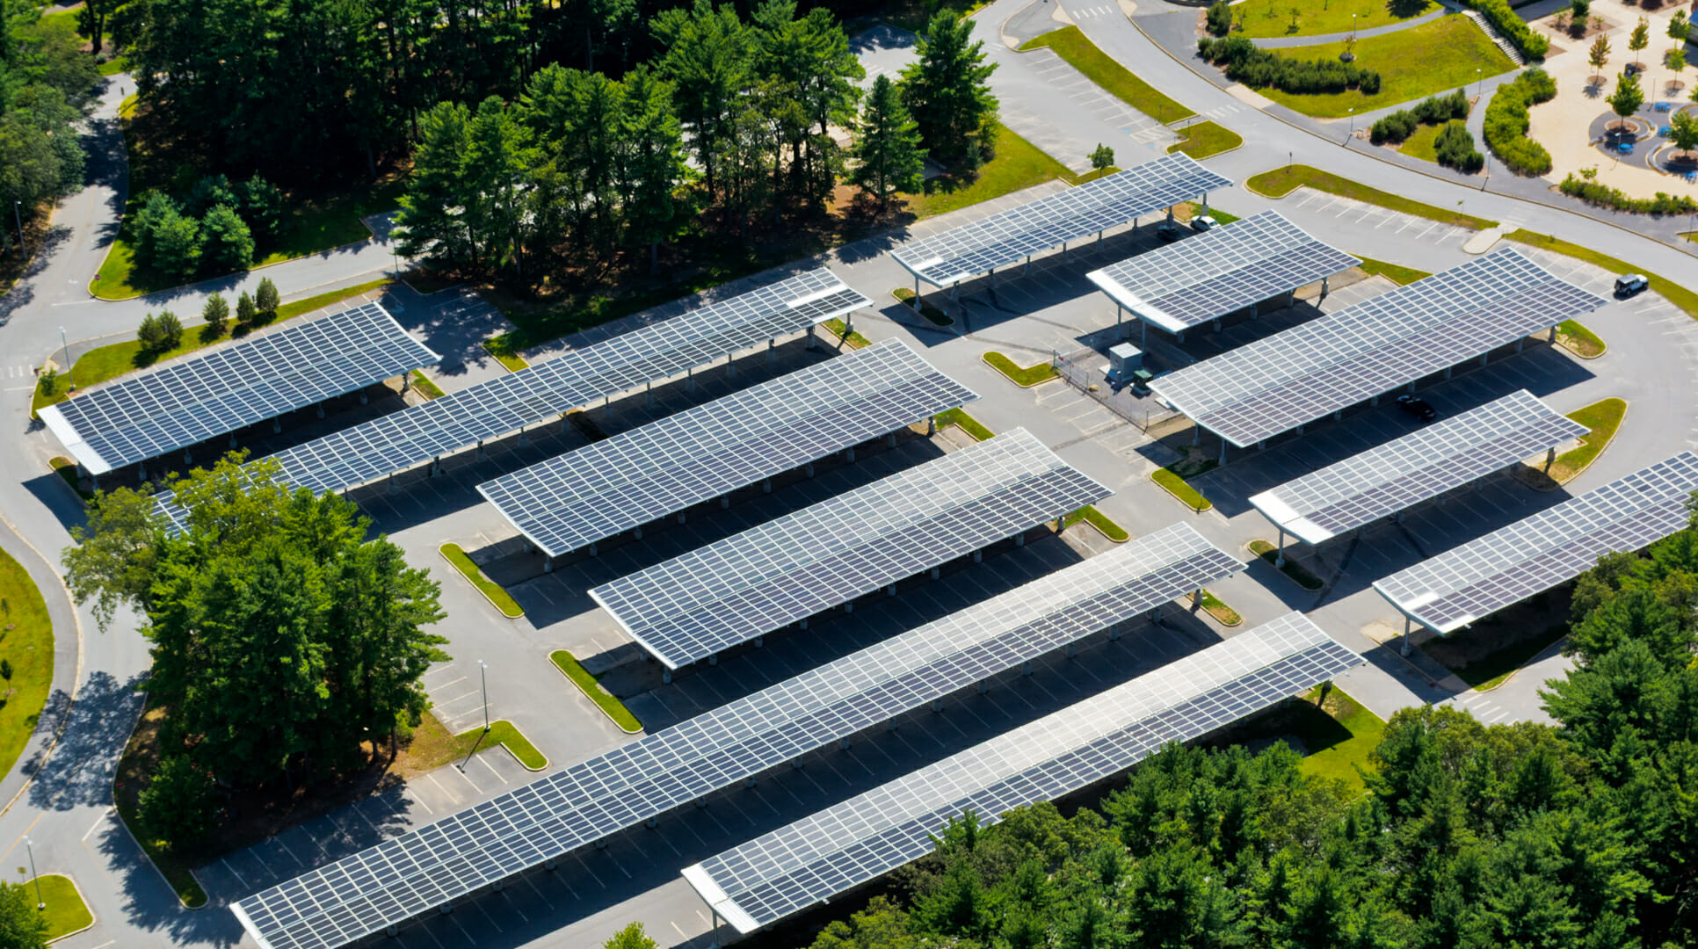
Think Outside of the Box
Solar parking canopies at Lincoln-Sudbury Regional High School, courtesy ForeFront Power.
Lesson 3: Climate Solutions for Our Homes and Schools
Notes:
Climate solutions for homes, schools, and communities don’t need to be complex.
Even small spaces can adopt creative climate solutions like solar parking canopies or energy-efficient windows.
For example, parking canopies may be an excellent option if your school doesn’t have much space on its rooftop for solar.
Plus, they protect vehicles (and people!) from the sun, rain, and snow.

Slide 15
Any building or space can adopt clean energy technologies such as weatherization, heat pumps, efficient appliances, and battery storage.
There are several careers that work to improve energy efficiency.
Climate solutions require creativity more than complexity.
Notes:
Clean energy technologies such as weatherization, heat pumps, solar, efficient appliances, smart controls, and battery energy storage can work in all buildings, including our homes and our schools.
I could have a career that improves the efficiency of my home or school and the quality of life for the occupants and other students.

Slide 16
Closing Activity
Identify one action you can take to increase your understanding or involvement in these solutions.
Write down your next step on a sticky note, and place it somewhere visible, such as on the front of your notebook or inside your locker.
Notes:
Examples of possible next steps:
Learn more about how solar energy works.
Put weatherization seals around the windows in my house.
Replace my light bulbs with LED bulbs.
Clarify what can and cannot be recycled in my neighborhood and school.
Ask my neighbor with solar panels on their roof why they installed them.
Research careers in energy-efficient building design and construction.
Talk to a friend or family member who works in the clean energy or climate industry about their job training.

Slide 17
Clean energy careers support individuals, families, and communities. A career in clean energy empowers you to do well by doing good.
Lesson 3: Climate Solutions for Our Homes and Schools
|
Notes:
This lesson is focused on how we can make everyday spaces more climate-friendly.

